Slide 1
Chapter 11
CFX Expression Language
(CEL)
Introduction to CFX

Slide 2
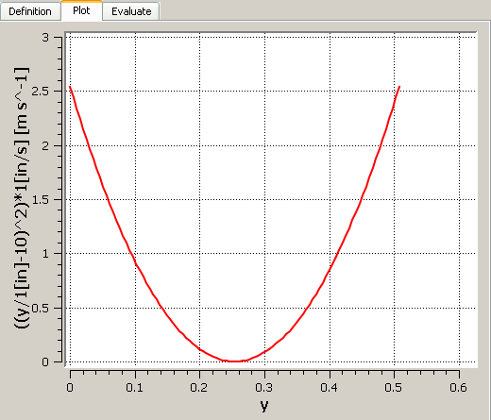
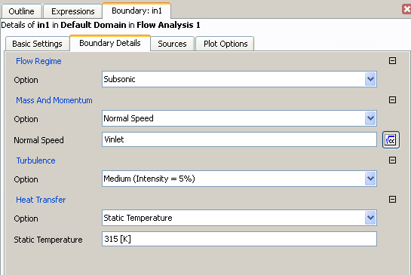
CEL
CEL - CFX Expression Language
  Allows the user to create equations (can be functions of solution/system variables) that can be used in CFX-Pre and CFD-Post
Example:

Slide 3
CEL Rules
The syntax rules are the same as those for conventional arithmetic. Operators are written as:
    + (addition) - (subtraction) * (multiplication)
    / (division) ^ (exponentiation)
Variables and expressions are case sensitive (example: t vs. T)
Expressions must be dimensionally consistent for addition and subtraction operations (example: 1.0 [mm] + 0.45 [yds] is OK)
  You cannot add values with inconsistent dimensions
Fractional and decimal powers are allowed (example: a^(1/2) + 1.0^0.5)
Units of expressions are not declared – they are the result of units in the expression (example: a [kg m^-3] * b [m s^-1] has units of [kg m^-2 s^-1]
Some constants are also available in CEL for use in expressions:
  e Constant: 2.7182818
  g Acceleration due to gravity: 9.806 [m s^-2]
  pi Constant: 3.1415927
  R Universal Gas Constant: 8314.5 [m^2 s^-2 K^-1]

Slide 4
Built In Functions
Numerical functions and operators are also available in CEL
  Right-click when creating expressions for a complete list
  Custom functions with User Fortran can also be created
Function Operand’s Dimensions [x] Operand’s Values Result’s Dimensions
sin(x) Angle Any Dimensionless
cos(x) Angle Any Dimensionless
tan(x) *** Angle Any Dimensionless
asin(x) Dimensionless -1 ≤ x ≤ 1 Angle
acos(x) Dimensionless -1 ≤ x ≤ 1 Angle
atan(x) Dimensionless Any Angle
exp(x) Dimensionless Any Dimensionless
loge(x) Dimensionless 0 < x Dimensionless
log10(x) Dimensionless 0 < x Dimensionless
abs(x) Any Any [x]
sqrt(x) Any 0 ≤ x [x]^0.5
if(test, res1, res2)* Any Any Any (res1 and res2 must have the same dimensions)
min(x,y) **** Any Any [x]
max(x,y) **** Any Any [x]
step(x) * Dimensionless Any Dimensionless
*if functions contain a test, and two result outcomes. The first outcome, res1 will be returned if test evaluates to true. If test evaluates to false, res2 is returned. Consider the following example, where we wish to set volume fraction to 1 when X is greater than 1 [m], and 0 if X is less than 1 [m]:
if (x>1[m], 1, 0)
In this case, if the result is precisely equal to 1[m], the result is (res1+res2)/2
**step(x) is 0 for negative x, 1 for positive x and 0.5 for x=0.
*** note that tan(x) is undefined for nπ/2 where n=1, 3, 5 .. .
**** both x and y must have the same dimensions.

Slide 5
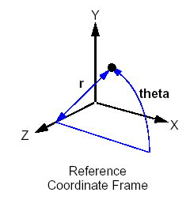
Solver Variables
Solver variables are available for use in any expression
Below is a partial list of the available system variables:
  When creating expressions, right-click to access a full list
x Direction 1 in Reference Coordinate Frame
y Direction 2 in Reference Coordinate Frame
z Direction 3 in Reference Coordinate Frame
r Radial spatial location, r = (x^2+y^2)^0.5
theta Angle, arctan(y/x)
t Time
u Velocity in the x coordinate direction
v Velocity in the y coordinate direction
w Velocity in the z coordinate direction
p (absolute) Pressure
ke Turbulent kinetic energy
ed Turbulent eddy dissipation
T Temperature
sstrnr Shear strain rate
density Density
rNoDim Non-dimensional radius (rotating frame only)
viscosity Dynamic Viscosity
Cp Specific Heat Capacity at Constant Pressure
cond Thermal Conductivity
AV name Additional Variable name
mf Mass Fraction
Depending on your physics, some variables will not be valid – e.g. you need to solver heat transfer to use T

Slide 6
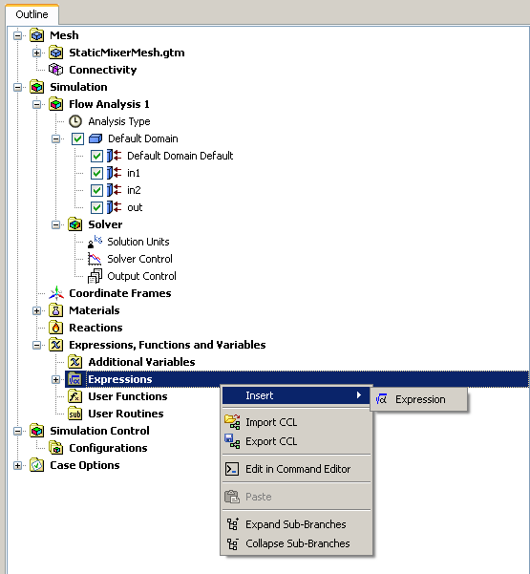
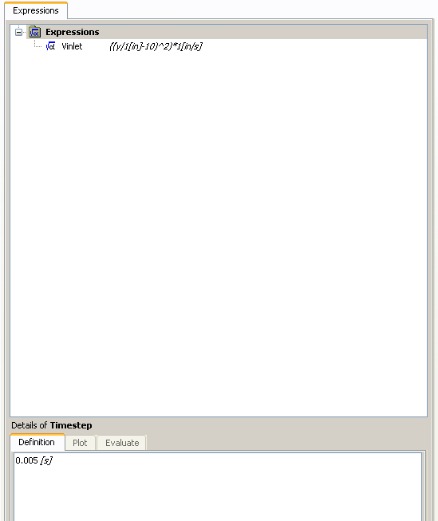


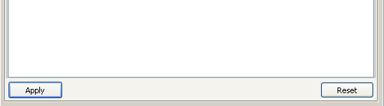
How To Create Expressions

Slide 7
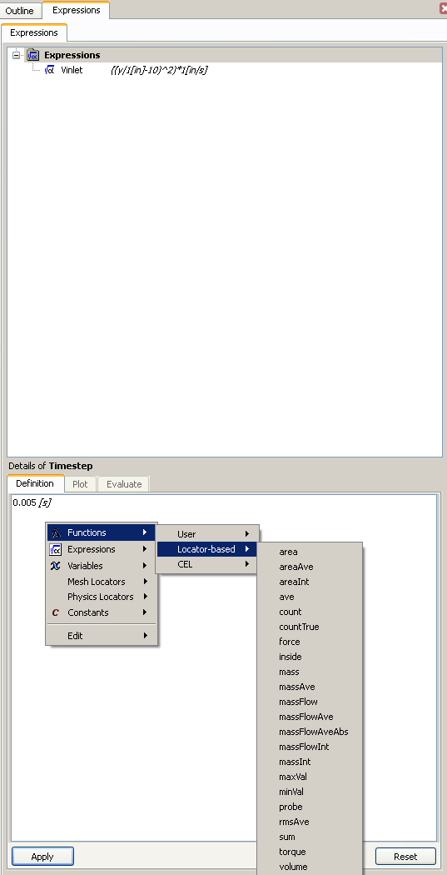
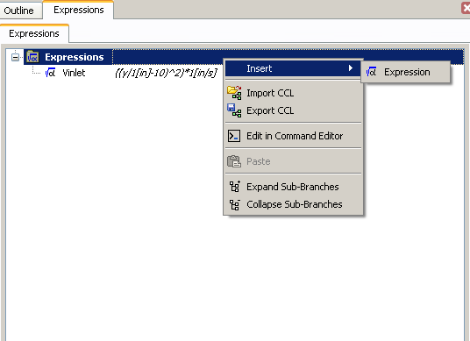
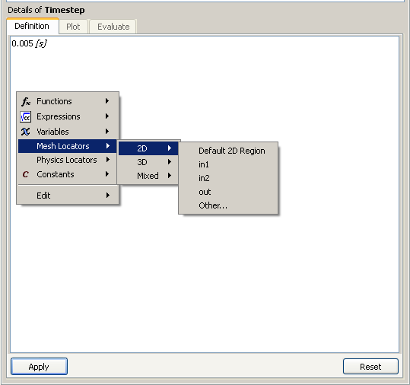
How To Create Expressions
To add more expressions (similar method in CFD-Post)
Right-click in the Definition window to access Variables, Constants, Functions, Locators and existing Expressions

Slide 8
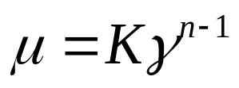
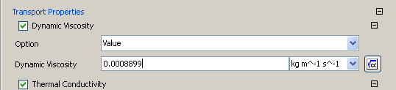
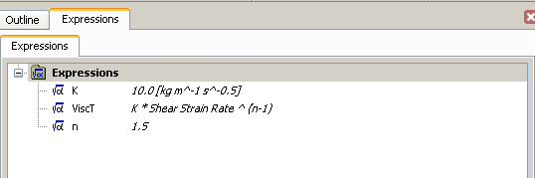
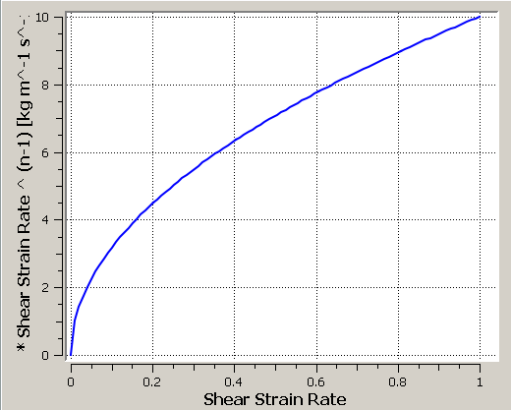
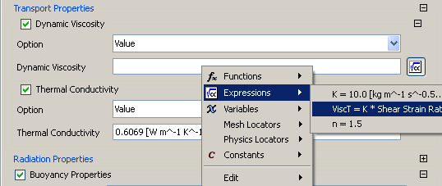
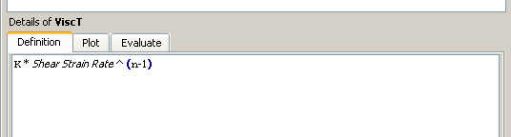
CEL in CFX-Pre: Example 1
Creating a variable viscosity
  Viscosity of a shear thickening fluid:
  where γ is the shear strain rate
Solver Variable and Expression Name are both accessed via the right mouse button

Slide 9
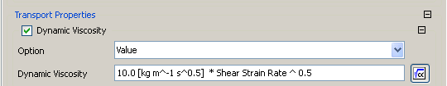
CEL in CFX-Pre: Example 1
Alternatively, an expression can be entered directly into a field

Slide 10
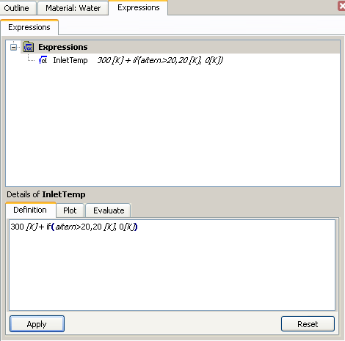
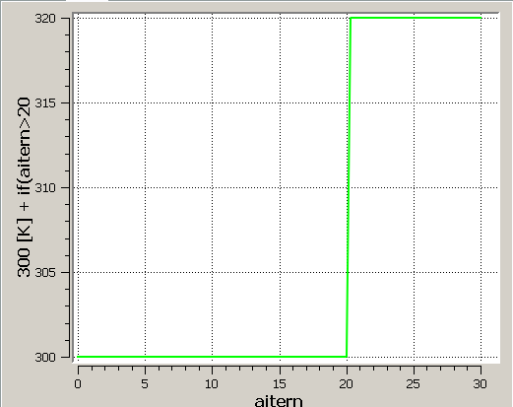
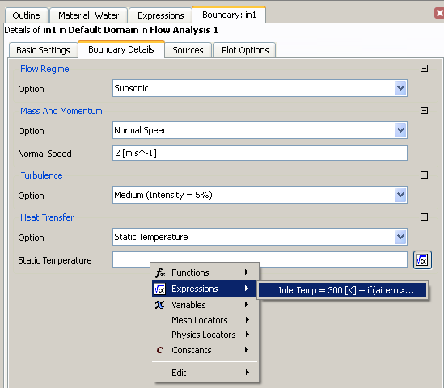
CEL in CFX-Pre: Example 2
Using an “if” Function
  Set inlet temperature to 300 K for the first 19 iterations then raise it to 320 K after 20 iterations
Solver variable accessed with the right mouse button
Note: On the 21st iteration inlet temp = 310 K

Slide 11
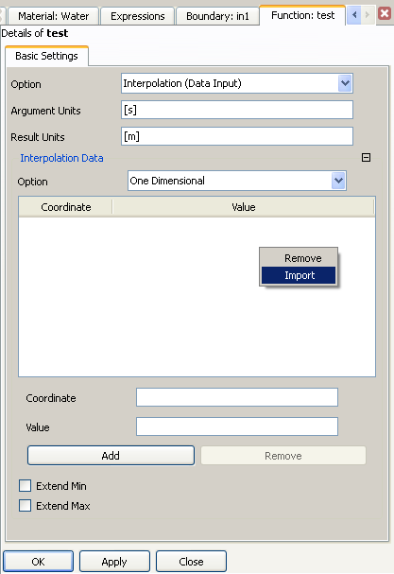
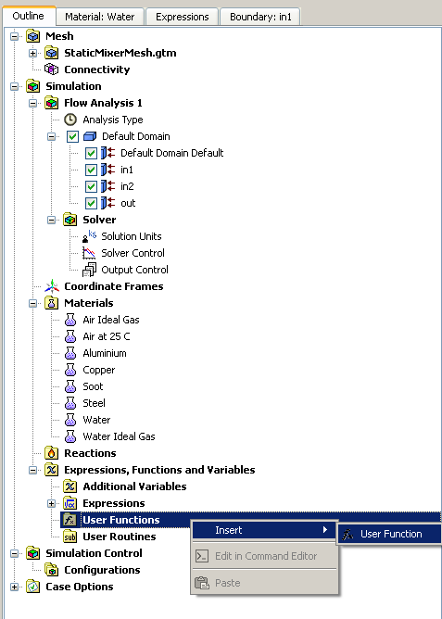
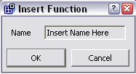
User Functions
You can also define your own 1-D linear, or 3-D cloud of points interpolation functions
Import data points or add manually

Slide 12
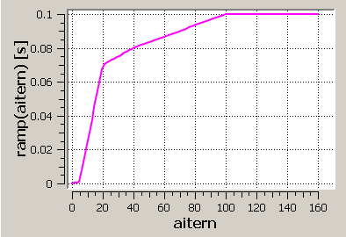
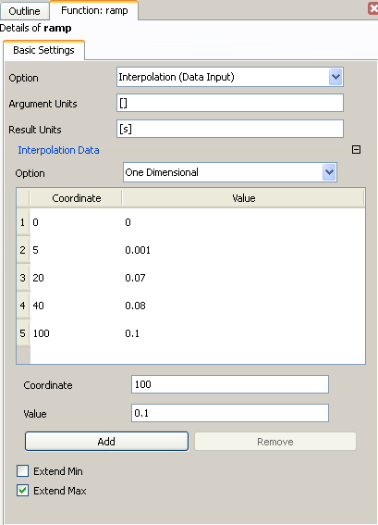
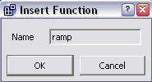
User Functions: Example
Example: Having the timestep change
with iteration number as shown here
Iteration Number is dimensionless
Timestep size is in seconds
Continued on next slide...

Slide 13
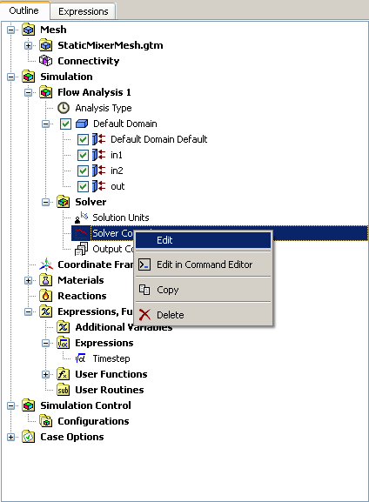
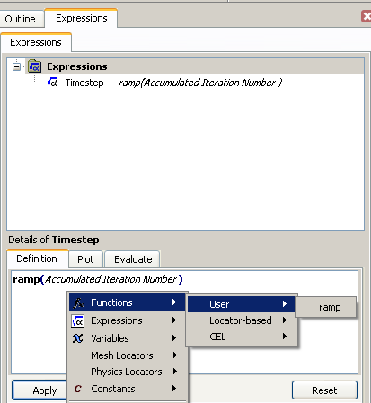
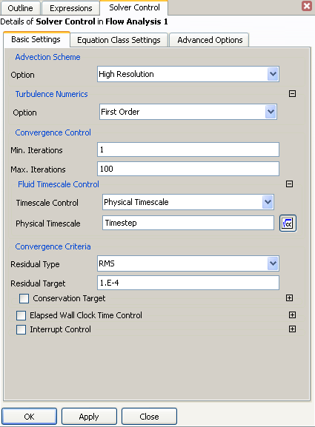

User Functions: Example
Example: Having the timestep change
  with iteration number as shown here

Slide 14
Integrated Quantities
Integrated quantities can be used in expressions to evaluate variables over some location
  Examples:
  Calculate the area average of Cp on an isosurface: areaAve(Cp)@iso1
  Mass flow of particular fluid through a locator: oil.massFlow()@slice1
Available in CFX-Pre and CFD-Post
  Usage is more strict in CFX-Pre
    E.g. the argument supplied to the function must be a variable, not an expression
“@<locator>” syntax must always supply a named location used in the physics definition
  A boundary condition name, a domain name, a monitor point name, etc.
To reference general mesh regions use the syntax “@REGION:<name>”
Phases/components can be referenced using:
[<phase name>.][<component name>.]<function>@<locator>
  E.g. Air.Nitrogen.massFlow()@outlet

Slide 15
Integrated Quantities
Some functions allow an x, y or z operator:
  area_x()@boundary gives the area projected in the x-direction
  force_z()@wall gives the z component of the force on the wall
  See documentation for a full list
These functions also allow an optional coordinate frame:
  force_z_MyCoord()@wall gives the z component of the force on the wall using the coordinate frame “MyCoord”
Each function requires either 0 or 1 arguments
  areaAve requires 1 argument: areaAve(Temperature)@Wall
  massFlow requires 0 arguments: massFlow()@Inlet
Return value units depend on the argument units
  areaAve(Temperature)@Wall will return a value with units of Temperature

Slide 16
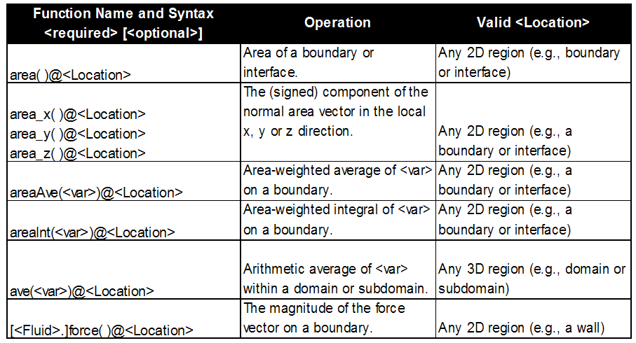
Integrated Quantities
Below is a partial list of functions
  See documentation for a complete list
  Right-clicking when creating an expression will show most functions

Slide 17
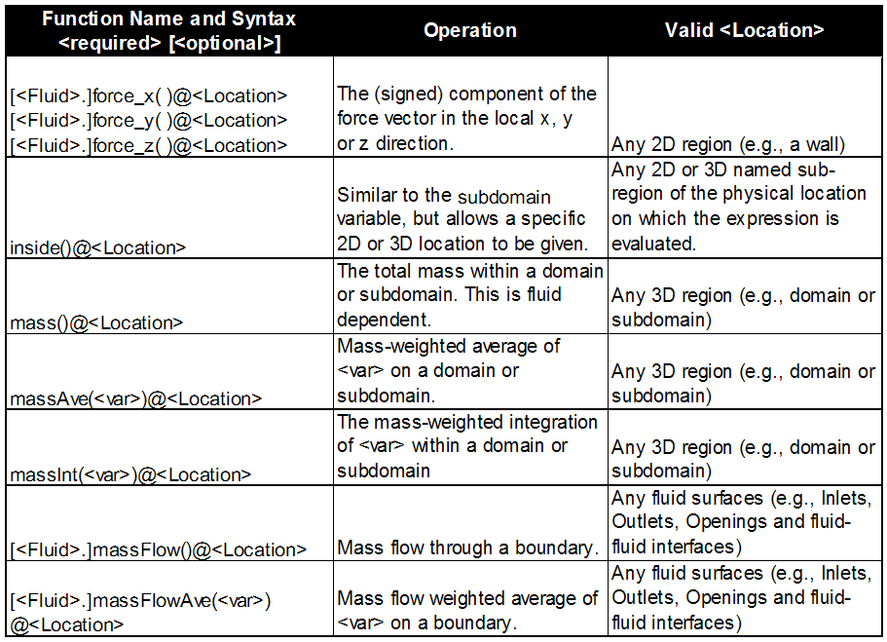
Integrated Quantities

Slide 18
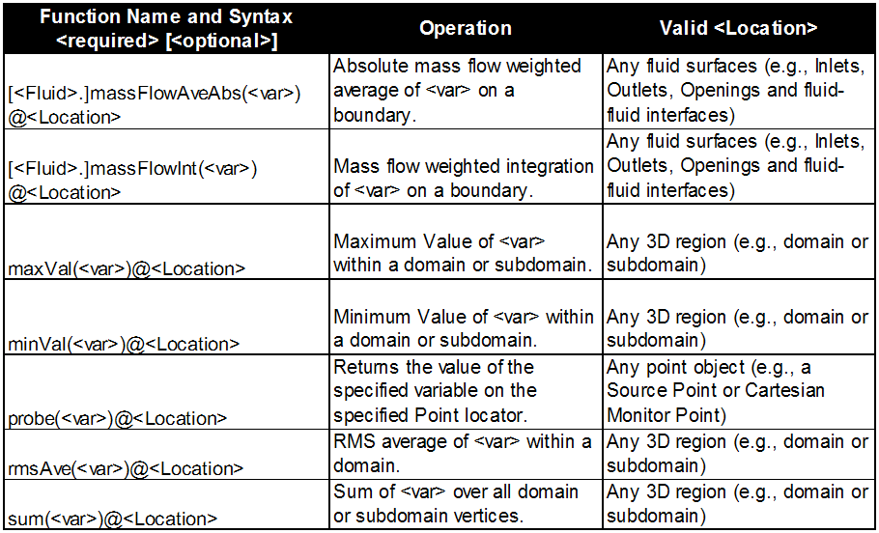
Integrated Quantities

Slide 19
Useful Functions
The inside() function returns 1 when inside the specified location and 0 when outside
  Useful to limit the scope of a function to a subdomain or boundary
The step() function return 1 when the argument is positive and 0 when the argument is negative
  Useful as an on-off switch
  if() function can also be used as a switch
areaAve() and massFlowAve() are used to evaluate the average of a quantity on a location
  areaAve() is an area-weighted average. It is usually used on wall boundaries and when the quantity is not “carried with the flow”, e.g. Pressure at an outlet, Temperature on a wall
  massFlowAve() is an average weighted by the local mass flow. It is usually used to evaluate quantities that are “carried with the flow”, e.g. Temperature at an outlet

